Slide 1



School of Information Technology
https://www.monash.edu.my/
FIT5226
Multi-agent System & Collective Behaviour
Week 4-1: GLIE, SARSA and Q-Learning
FIT3155 S2 2024
Prepared by: Bernd Meyer. Edited by: Fuad Noman
www.monash.edu.au

Slide 2



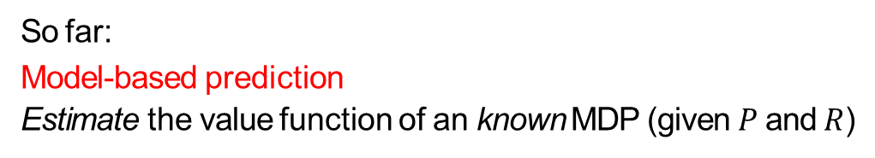

From Model-based Prediction to Model-free Control
So far:
Model-based prediction
Estimate the value function of an known MDP (given $P$ and $R$)
a a s′
v′(s) → max R + $γ$
∑
s′∈S
P v
s
s,s′ ⋆
a∈A
The goal:
Model-free control
Optimise the value function of an unknown MDP
8/15/2024
FIT5226-S2-2024
2/65
Notes:
Prediction: estimate the return values from future states.
Previous Lecture: Planning by dynamic programming to solve known MDP.

Slide 3

Step 1: From Model-based Prediction to Model-free-Prediction
To achieve model-free prediction (value estimation) we first need to get rid of the transition matrix that we use in model-based prediction to compute the expectation.
a
a s′
v′(s) → max R + $γ$
P v
s
∑
s′∈S
s,s′ ⋆
a∈A
We can use sampling instead.
In this way we will arrive at model-free estimation.
8/15/2024
FIT5226-S2-2024
3/65
Notes:
Get rid of the assumption that we have the true model and therefore we want to use experience samples to learn.
We do something in that environment and experience what happens next. Instead of calculating we experience so we use sampling for this.

Slide 4
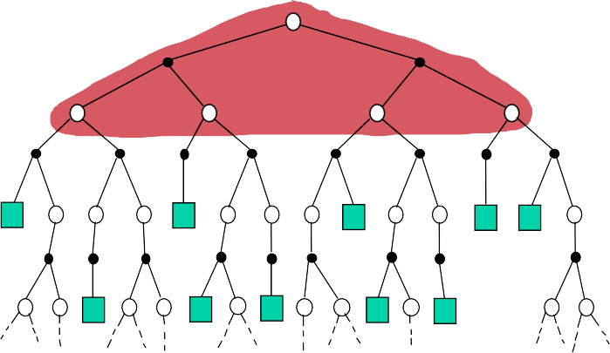
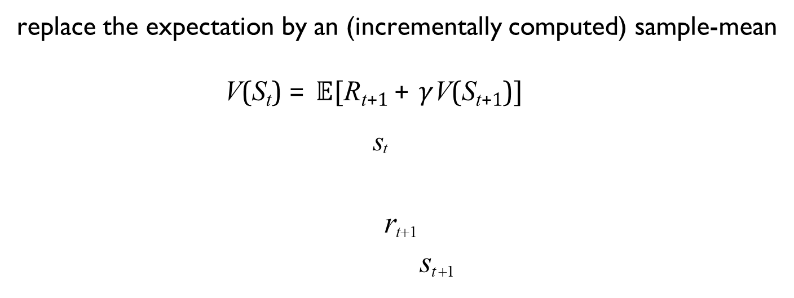
Sampling liberates us from needing a model
replace the expectation by an (incrementally computed) sample-mean
V(S_{t}) = 𝔼[R_{t+1} + $γ$V(S_{t+1})]
s_{t}
^{r}t+1
^{s}t +1
8/15/2024
FIT5226-S2-2024
4/65
Notes:
This is the state tree. Standing at state S_t, you could take one of two possible actions, that gives you a reward on that action arriving at state/node S_{t+1}.
Repeat this again and again. Till you reach the green leaf node (end of episode).

Slide 5
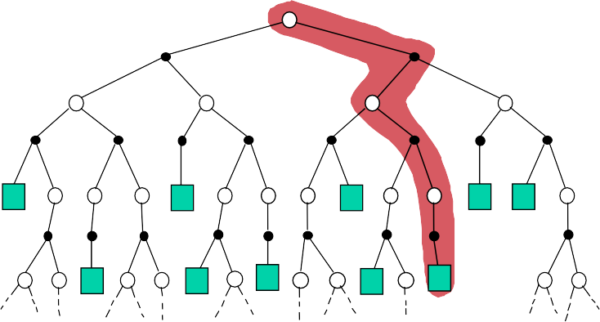
Monte-Carlo Update
V(S_{t}) ←
V(S_{t}) + α(G_{t} − V(S_{t}))
s_{t}
RL Terminology: the structure of the update is called a “backup”
8/15/2024
FIT5226-S2-2024
5/65
Notes:
Monte-Carlo is a model free method, we need no knowledge of the Markov decision process.
instead of looking at the whole area we only look at a possible path. Executing one episode until we hit the leaf node.

Slide 6
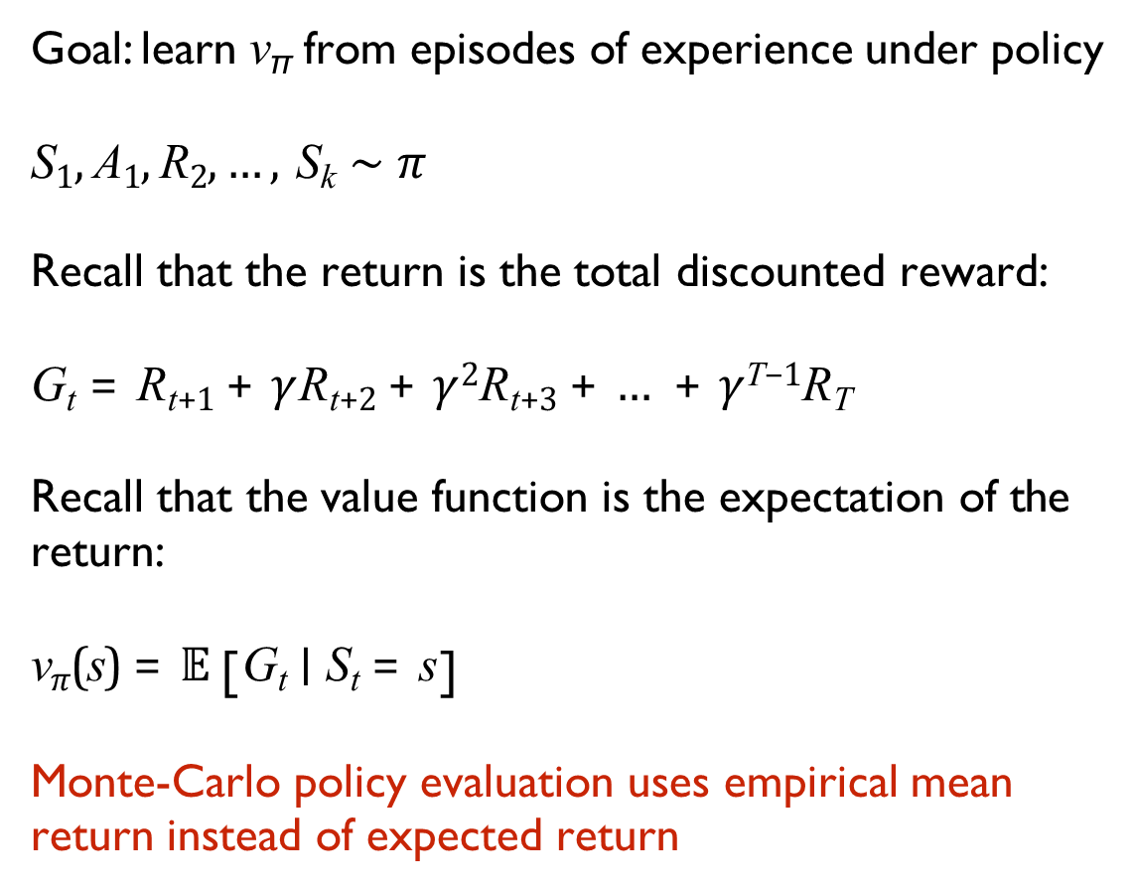
Monte-Carlo Policy Evaluation
Goal: learn v_{π} from episodes of experience under policy
S₁, A₁, R₂, …, S_{k} ∼ $π$
Recall that the return is the total discounted reward:
G_{t} = R_{t+1} + $γ$R_{t+2} + $γ$²R_{t+3} + … + $γ$^{T−1}R_{T}
Recall that the value function is the expectation of the return:
v$π$(s) = 𝔼 [G_{t} ∣ S_{t} = s]
Monte-Carlo policy evaluation uses empirical mean return instead of expected return
8/15/2024
FIT5226-S2-2024
6/65

Slide 7
To evaluate state s
Every-Visit Monte-Carlo Policy Evaluation
Every time-step t that state s is visited in an episode, Increment counter N(s) ← N(s) + 1
Increment total return S(s) ← S(s) + G_{t}
Value is estimated by mean return V(s) ← S(s)/N(s)
lim_{N(s)→∞} V(s) = v_{π}(s)
8/15/2024
FIT5226-S2-2024
7/65

Slide 8
Update the empirical mean of V(s) incrementally after episode S₁, A₁, R₂, …, S_{T}
Incremental Monte-Carlo Updates
For each state S_{t} with return G_{t}
1
V(S_{t}) ← V(S_{t}) + ₍(G − V(S )₎
N(S_{t})
t t
In non-stationary problems, it can be useful to track a running mean, i.e. forget old episodes:
V(S_{t}) ← V(S_{t}) + α(G_{t} − V(S_{t}))

Slide 9
Monte-Carlo Reinforcement Learning
MC methods learn directly from episodes of experience
MC is model-free: no knowledge of MDP transitions or rewards
MC learns from complete episodes: no bootstrapping
MC uses the simplest possible idea: value = mean return
Caveat:
MC can only be applied to episodic MDPs
All episodes must terminate
8/15/2024
FIT5226-S2-2024
9/65
Notes:
Complete Episodes: MC methods learn from the complete trajectories of episodes, from the initial state to the terminal state. This means that the agent doesn't update its value estimates until the end of each episode, when the true cumulative return is known.
No Bootstrapping: "No bootstrapping" means that MC methods do not use estimates of future values to update their value estimates. Instead, they rely entirely on the actual rewards obtained in the episode. There's no forward-looking estimation involved; the agent waits until the episode ends to compute and update its value function estimates based on the total return.
This approach has certain implications:
MC methods are well-suited for episodic tasks, where the learning process is guided by complete episodes, such as games with finite episodes (e.g., a game of chess, a hand of poker).
MC methods can handle stochastic environments (where outcomes are uncertain) and environments with delayed rewards.
Since MC methods require full episodes, they may have higher variance due to the noise in the observed returns.

Slide 10
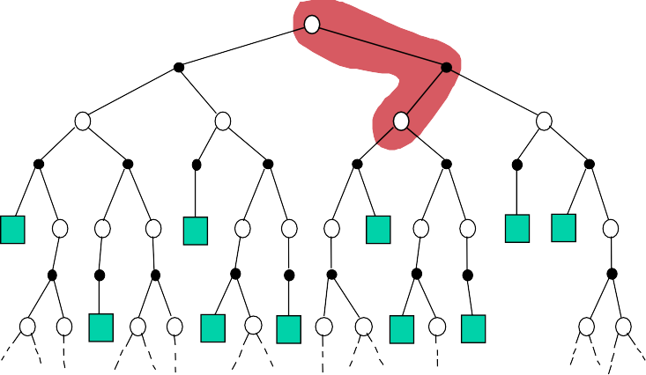
Temporal-Difference Update
V (St ) ← V (St ) + α (Rt+1 + γV (St+1) − V (St ))
s_{t}
^{R}t+1
^{s}t +1
8/15/2024
FIT5226-S2-2024
10/65
Notes:
Alpha: learning step size, decreases over time. V(S_{t+1}) is initially guessed (zero/random) and hence V(S_t) is guessed.
In contrast, temporal difference (TD) methods, such as SARSA and Q-learning, do involve bootstrapping by updating value estimates based on estimates of future values. They update estimates at each time step based on the observed reward and the agent's estimate of the value of the next state. This enables TD methods to learn from incomplete episodes and online interactions with the environment.

Slide 11
Monte-Carlo versus Temporal Difference
Goal: learn V_{π} online from experience under policy
Incremental every-visit Monte-Carlo
Update value V(S_{t}) toward actual return G_{t} V(S_{t}) ← V(S_{t}) + α(G_{t} − V(S_{t}))
Simplest temporal-difference learning algorithm:TD(0)
Update value V(S_{t}) toward estimated return R_{t+1} + γV(S_{t+1}) V(S_{t}) ← V(S_{t}) + α(R_{t+1} + γV(S_{t+1}) − V(S_{t}))
R_{t+1} + γV(S_{t+1}) is called the TD target
δ_{t} = R_{t+1} + γV(S_{t+1}) − V(S_{t}) is called the TD error
8/15/2024
FIT5226-S2-2024
11/65
Notes:
The formula of TD differs from MC only by replacing the G_t term with TD target term.

Slide 12
Advantages and Disadvantages of MC vs. TD
TD can learn before and without the final outcome
TD can learn online after every step
MC must wait until end of episode before return is known
TD can learn from incomplete sequences MC can only learn from complete sequences
TD works in continuing (non-terminating) environments
MC only works for episodic (terminating) environments
8/15/2024
FIT5226-S2-2024
12/65
Notes:
With TD we can handle infinite episodes, we don’t have to go all the way to the terminal nodes.

Slide 13

Advantages and Disadvantages of MC vs. TD (cont’d)
MC has high variance, zero bias
good convergence properties
not very sensitive to initial value
very simple to understand and use
TD has low variance, some bias
usually more efficient than MC
TD(0) converges to v$π$(s) (with value tables)
more sensitive to initial value
8/15/2024
FIT5226-S2-2024
13/65
Notes:
MC Zero Bias: The estimated value of a state is the average of the cumulative rewards received when starting from that state and following a policy until the end of the episode. Since MC methods rely on real experience and the actual rewards received, they are unbiased estimators.
TD Biased: TD methods, on the other hand, update value estimates based on the difference between the current estimated value and an estimate of the next state's value. TD methods make updates at each time step, using bootstrapping (estimating a value based on an estimate) to update the current state's value using information from the next state. This introduces a level of bias in the estimation process.
In summary, the key distinction between MC and TD methods is the way they estimate values and update their estimates. MC methods are unbiased but require complete episodes, while TD methods are biased due to bootstrapping but can learn more efficiently in some situations.
MC high variance: MC methods tend to have higher variance in their value estimates. This is because MC methods estimate values based on the actual returns obtained from complete episodes, which can vary widely from one episode to another due to randomness and uncertainty in the environment. Since each episode provides an independent estimate of the value, the variance in the estimates can be relatively high. This can lead to slower convergence and more noise in the learning process.
TD low variance: TD methods generally have lower variance compared to MC methods. TD methods update value estimates based on the difference between the current estimated value and an estimate of the next state's value. This bootstrapping approach introduces a degree of smoothing and control over the learning process, which tends to reduce the variance in value estimates. TD methods are more suited for online learning and situations where complete episodes are not required.
It's important to note that the trade-off between variance and bias is a fundamental concept in statistical and machine learning methods. MC methods have lower bias but higher variance, while TD methods have lower variance but some level of bias due to bootstrapping. The choice between MC and TD methods often depends on the specific problem, the nature of the environment, and the trade-offs that the learning algorithm needs to make.

Slide 14
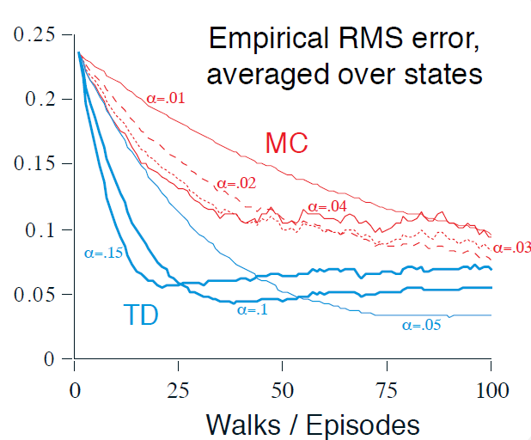
Random Walk: MC vs. TD
8/15/2024
FIT5226-S2-2024
14/65
Notes:
The graph shows learning curves for the two methods for various values of $α$. The performance measure shown is the root mean-squared (RMS) error between the value function learned and the true value function, averaged over the five states, then averaged over 100 runs. In all cases the approximate value function was initialized to the intermediate value V (s) = 0.5, for all s. The TD method was consistently better than the MC method on this task.

Slide 15





Step 2: From Model-free Prediction to Control
Ultimately, we need to find the optimal policy
So far we have worked with the state-value function V(s)
Greedy policy improvement over V(s) requires model of MDP
π′(s) = argmax Rª + Pª V(s′)
s
s,s′
a∈A
We can instead directly work with the action-state-value function.
Greedy policy improvement over Q(s, a) is model-free
π′(s) = argmax Q(s, a)
a∈A
But now we need to find Q instead of V !
8/15/2024
FIT5226-S2-2024
15/65
Notes:
Greedy policy: is the decision-making strategy where an agent always chooses the best immediate action or value.

Slide 16
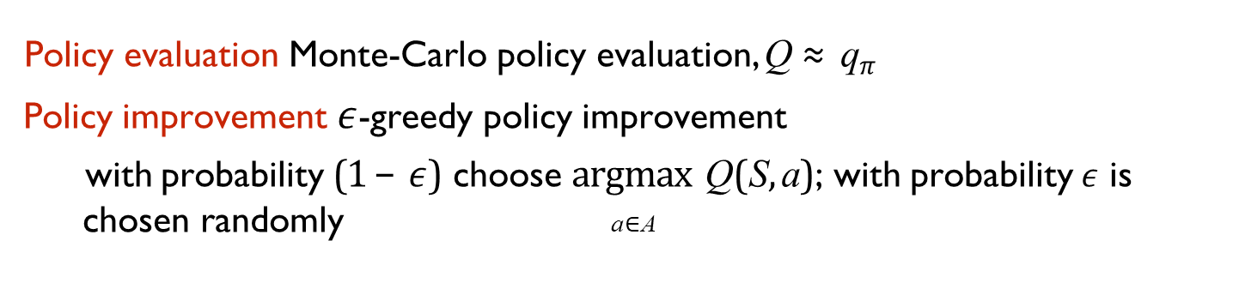
Monte-Carlo Policy Iteration (simple)
The goal is to find a policy that maximizes the expected cumulative reward.
Policy evaluation Monte-Carlo policy evaluation, Q ≈ q$π$
Policy improvement $ε$-greedy policy improvement
with probability (1 − $ε$) choose argmax Q(S, a); with probability $ε$ is chosen randomly a∈A
There are alternative ways to handle the policy improvement but they must be GLIE
8/15/2024
FIT5226-S2-2024
16/65
Notes:
Exploitation (1 - ε): With probability (1 - epsilon), the agent selects the action that has the highest estimated value according to its current knowledge. This is the "greedy" part of the policy, as it exploits the agent's current understanding of which action is best.
Exploration (ε): With probability epsilon, the agent chooses a random action. This allows the agent to explore other actions and potentially discover better options that it might not have considered otherwise.
Argmax {$a \in A$} {$Q(S, a)$: This notation represents finding the action (a) that maximizes the Q-value (state-action value) for a given state (S) from the set of possible actions (A). The Q-value represents the expected cumulative reward the agent can obtain by taking a particular action in a specific state.
In epsilon-greedy policy improvement, the agent selects the action with the highest estimated value with probability 1 - ε (epsilon) and selects a random action with probability ε.

Slide 17
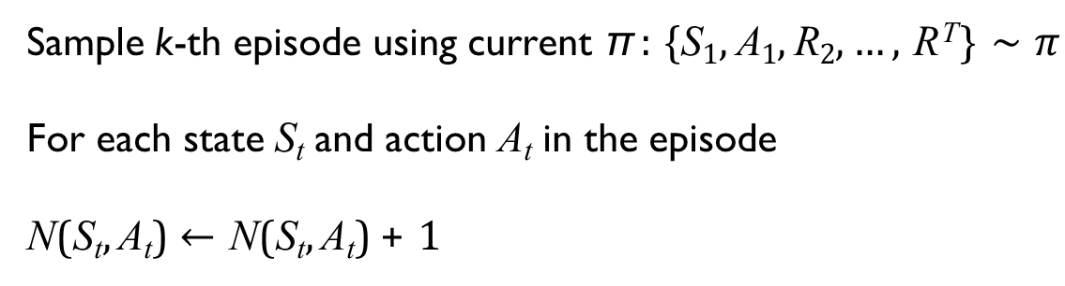
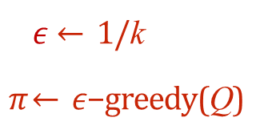
GLIE Monte-Carlo Control (Greedy in the limit with infinite exploration)
Sample k-th episode using current π : {S₁, A₁, R₂, …, R^{T}} ∼ $π$
For each state S_{t} and action A_{t} in the episode
N(S_{t}, A_{t}) ← N(S_{t}, A_{t}) + 1
1
running average
Q(S_{t}, A_{t}) ← Q(S_{t}, A_{t}) + ₍G − Q(S , A )₎
N(S_{t}, A_{t})
t t t
NewEstimate = OldEstimate + StepSize * (Target - OldEstimate)
Incremental Update Formula
Improve policy based on new action-value function
$ε$← 1/k
$π$← $ε$−greedy(Q)
Infinite Exploration Greedy in the limit
Theorem
GLIE Monte-Carlo control converges to the optimal action-value function
Q(s, a) → q⋆(s, a)
Notes:
The GLIE ensures the policy becomes increasingly greedy (favoring actions with higher estimated values) as it gathers more experience while still exploring to guarantee convergence to an optimal policy.
Never stop exploring could lead the convergence problem. Solution: reduce epsilon gradually towards zero.
Infinite exploration: the agent balances exploration and exploitation by gradually reducing exploration as it gains more experience. This helps in finding a near-optimal policy while ensuring that all actions are still explored infinitely often. The exploration rate decreases over time, allowing the agent to learn and refine it is policy while maintaining a degree of exploration to avoid getting stuck in suboptimal solutions.
N(S_t, A_t) represents the number of times the state-action pair (S_t, A_t) has been visited.
Q(S_t, A_t) is the estimated action-value (Q-value) function for state S_t and action A_t.
G_t denotes the cumulative future rewards (return) obtained after time step t.

Slide 18
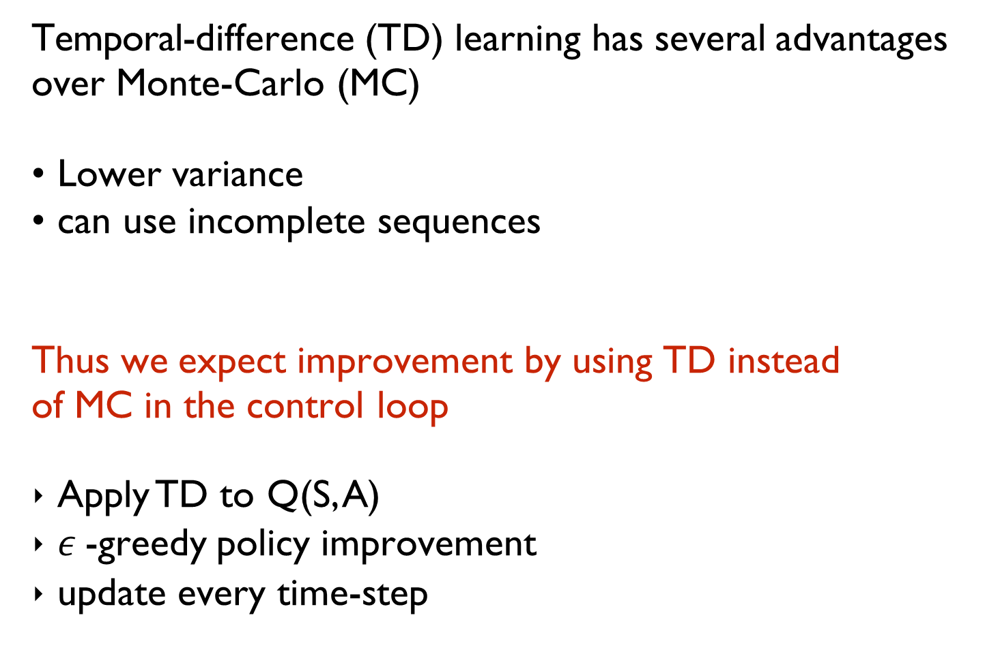
MC vs. TD for Control
Temporal-difference (TD) learning has several advantages over Monte-Carlo (MC)
Lower variance
can use incomplete sequences
Thus we expect improvement by using TD instead of MC in the control loop
Apply TD to Q(S, A)
$ε$-greedy policy improvement
update every time-step
8/15/2024
FIT5226-S2-2024
18/65
Notes:
Monte Carlo (MC):
Monte Carlo methods estimate state or state-action values by simulating entire episodes and averaging the observed returns.
MC methods do not require a model of the environment and can handle stochastic environments and delayed rewards.
MC methods update the value function estimates based on complete episodes, making them suitable for episodic tasks.
MC methods have higher variance because they rely on complete episode returns, which can be noisy.
Temporal Difference (TD):
Temporal Difference methods estimate values by bootstrapping, meaning they update value estimates based on estimates of future values.
TD methods update the value function estimates at each time step, allowing them to learn from incomplete episodes and online interactions with the environment.
TD methods require less memory compared to MC methods, as they do not need to store entire episodes.
TD methods strike a balance between the high variance of MC methods and the high bias of dynamic programming methods.

Slide 19
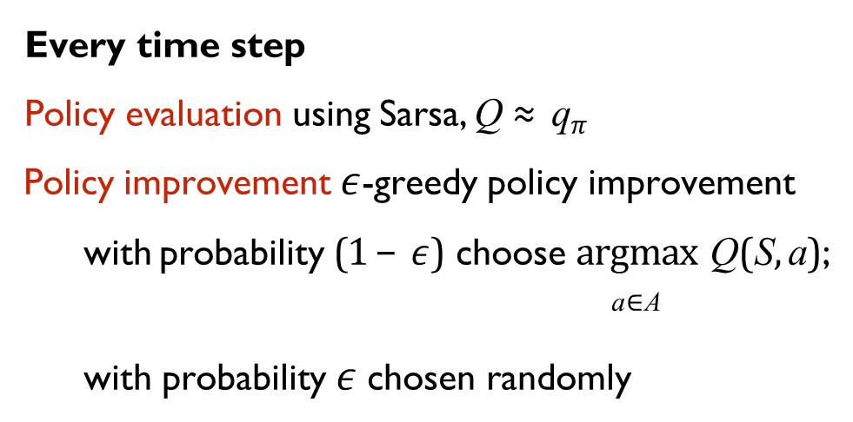
Policy Iteration with Sarsa
Every time step
Policy evaluation using Sarsa, Q ≈ q$π$
Policy improvement $ε$-greedy policy improvement with probability (1 − $ε$) choose argmax Q(S, a);
a∈A
with probability $ε$chosen randomly
Q(S, A) ← Q(S, A) + α ₍R + γQ(S′, A′) − Q(S, A)₎
8/15/2024
FIT5226-S2-2024
19/65
Notes:
SARSA: "State-Action-Reward-State-Action." The SARSA algorithm updates its action-value estimates based on the observed sequence of events (S, A, R, S', A').
SARSA is a specific TD method used for estimating action-values in an on-policy manner.
In SARSA, the value updates are based on the current policy's action selection and the subsequent action taken.
SARSA learns directly from the interactions it has with the environment using the current policy, which makes it suitable for online learning and policy improvement.
The name "SARSA" stands for State, Action, Reward, Next State, Next Action, indicating the sequence of events involved in its updates.

Slide 20
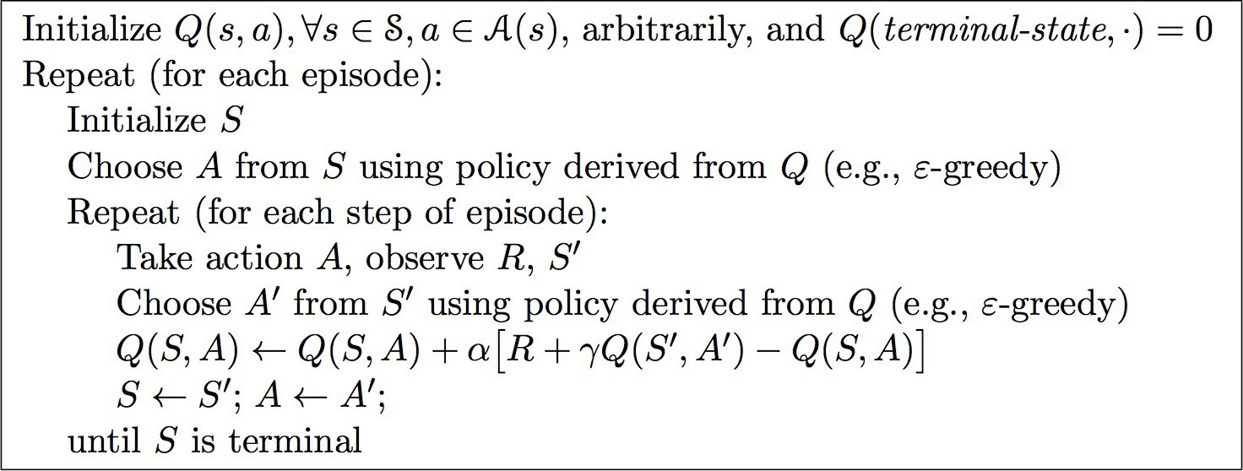
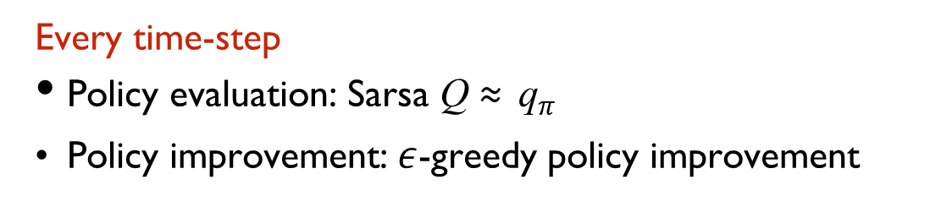
SARSA Algorithm for On-Policy Control
Every time-step
Policy evaluation: Sarsa Q ≈ q$π$
Policy improvement: $ε$-greedy policy improvement
8/15/2024
FIT5226-S2-2024
20/65

Slide 21
SARSA - TD Backups
We now only consider sample TD-backups
Using sample rewards and sample transitions
S, A
R S’
(S, A, R, S )
We do not need the reward function R and transition dynamics P
Advantages:
Model-free: no advance knowledge of MDP required
Breaks the curse of dimensionality through sampling
Cost of an individual backup is constant, independent of n = |S|
8/15/2024
FIT5226-S2-2024
21/65
Notes:
In reinforcement learning (RL), Temporal Difference (TD) backups refer to a mechanism used to update value function estimates based on the observed transitions and rewards experienced by an agent while interacting with an environment. TD backups are a fundamental concept in TD learning algorithms, which combine ideas from both Monte Carlo (MC) methods and dynamic programming.
The term "backup" originates from the notion that the value estimate at a particular state is updated by propagating information from subsequent states back to the current state. This propagation of information occurs over time steps, allowing the agent to gradually improve its estimates of state values or action-values.
Here's a general explanation of how TD backups work:
Estimate Update: At each time step, the agent observes a state, takes an action, receives a reward, transitions to a new state, and takes a new action. It uses this information to update its value estimates based on the observed reward and the estimated value of the next state.
Bootstrapping: TD backups involve bootstrapping, which means updating the current value estimate using an estimate of the value at the next state. This estimate is based on the agent's current knowledge of the value function.
Temporal Difference Error: The difference between the observed reward and the sum of the observed reward and the estimated value of the next state is known as the temporal difference (TD) error. This error is used to guide the value update and correct the current estimate.
Update Rule: The value estimate for the current state is updated using the TD error and a step size (learning rate) factor. The updated value estimate becomes a weighted combination of the current estimate and the new estimate from the observed reward and the estimated value of the next state.
TD backups allow the agent to learn online and incrementally, updating its value estimates after each time step. This enables the agent to learn from incomplete episodes and adapt to changes in the environment. TD methods strike a balance between the high variance of Monte Carlo methods and the high bias of dynamic programming methods, making them well-suited for many RL problems.
Overall, TD backups play a crucial role in TD learning algorithms, including SARSA and Q-learning, by guiding the agent's value function updates based on observed transitions and rewards.

Slide 22
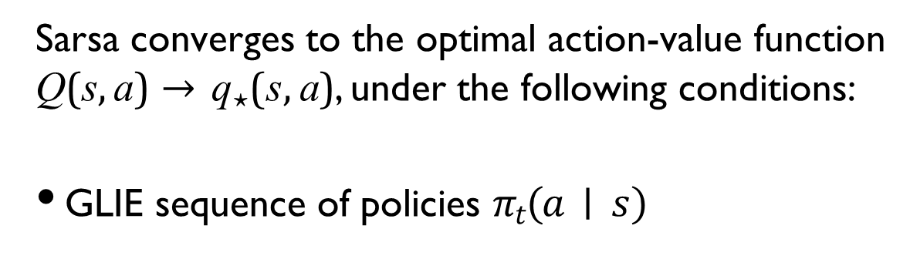
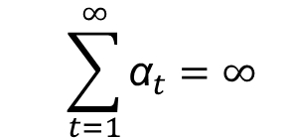
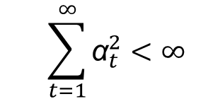
Convergence of Sarsa
Theorem
Sarsa converges to the optimal action-value function
Q(s, a) → q⋆(s, a), under the following conditions:
GLIE sequence of policies $πt(a∣s)$
Robbins-Monro sequence of step-sizes α_{t}
$$\sum_{t=1}^{∞}{{\text{α}}_{t}=∞}$$

$$\sum_{t=1}^{∞}{{\text{α}}_{t}^{2}<∞}$$

8/15/2024
FIT5226-S2-2024
22/65
8/15/2024
FIT5226-S2-2024
22/65
Notes:
GLIE: It is a property of learning algorithms in reinforcement learning that ensures convergence to an optimal policy. The GLIE sequence of policies 𝜋𝑡(𝑎∣𝑠) represents the way in which the agent's policy evolves over time as it interacts with the environment and learns.
SARSA can exhibit the GLIE property, meaning that, if the exploration strategy is appropriately designed and the learning rate is properly tuned, SARSA can converge to an optimal policy as the number of time steps approaches infinity.
In the context of reinforcement learning, the Robbins-Monro sequence of step-sizes is used to adjust the learning rate over time as the agent interacts with the environment. The step-size sequence is typically designed to satisfy the following conditions:
Step-Size Sequence: The sequence of step-sizes αt should be positive, non-increasing, and satisfy the following two conditions:
The sum of the step-sizes diverges (sum αt = ∞).
The sum of the squared step-sizes converges (sum αt^2 < ∞).
2.Convergence: Under these conditions, if the step-size sequence αt is properly chosen and the objective function being optimized satisfies certain regularity conditions, then the stochastic approximation algorithm can be proven to converge to the desired solution, even in the presence of noise or uncertainty.

Slide 23
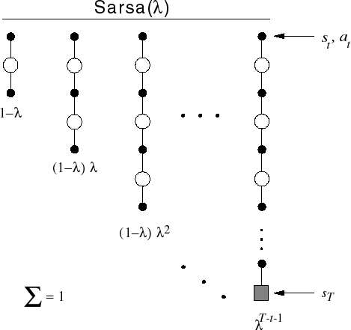
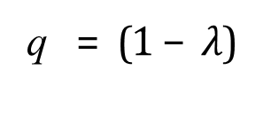



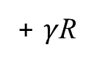
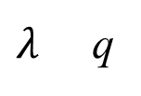

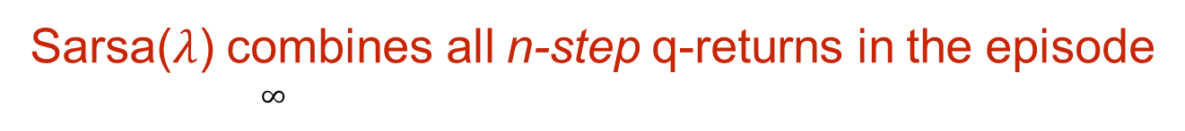
Sarsa(λ) and n-step Sarsa
n=1 Sarsa q
(1)
= R
+ $γ$Q(S )
t
t+1
t+1
n=2
q
(2)
= R
+ $γ$R
2
t+1
t+2
+ $γ$ Q(S )
t
t+2
…
n= ∞ MC q
(∞)
= R
T−1
t+1
+ $γ$R + … + $γ$ R
t
t+2
T
n-step Sarsa
Q(S_{t}, A_{t}) ← Q(S_{t}, A_{t}) + α q
(n)
− Q(S , A )
(
t
t t
)
Sarsa($λ$) combines all n-step q-returns in the episode
∞
∑
$λ$ n−1 (n)
q = (1 − $λ$)
$λ$ q
t
n=1
t
Q(S , A ) ← Q(S , A ) + α
(λ)
(
q − Q(
S , A )
)
t t t t
t
t t
8/15/2024
FIT5226-S2-2024
23/65
Notes:
λ (lambda) in SARSA(λ) is a parameter that takes a value between 0 and 1. It controls the balance between short-term and long-term rewards in the learning process.
When λ = 0: The agent focuses solely on one-step updates, similar to the basic SARSA algorithm. The eligibility traces have no effect, and only the immediate reward and the value of the next state-action pair are considered in the update.
When λ = 1: The agent considers full Monte Carlo updates, incorporating rewards from the entire episode. The eligibility traces become persistent, and all past actions contribute to the update.
When 0 < λ < 1: The agent blends both short-term and long-term effects. The eligibility traces decay over time, allowing the agent to balance between recent and distant experiences.
SARSA(λ), is an extension of the SARSA algorithm that incorporates eligibility traces to provide a trade-off between one-step TD updates (as in standard SARSA) and full Monte Carlo updates. The λ parameter in SARSA(λ) controls the balance between these two extremes.
SARSA(λ) - Eligibility Traces:
In SARSA(λ), the key addition is the use of eligibility traces. Eligibility traces keep track of the recent history of state-action pairs visited by the agent.
These traces help in incorporating information from multiple time steps into the learning process. The λ parameter determines the decay rate of eligibility traces, controlling the balance between immediate and delayed rewards.
SARSA(λ) updates value estimates using TD updates that involve the eligibility trace and are a blend of one-step TD updates (as in basic SARSA) and full Monte Carlo updates.
SARSA(λ) allows for a smooth trade-off between short-term learning and long-term planning by controlling the λ parameter. It helps address the bias-variance trade-off present in basic SARSA.
n-step SARSA:
n-step SARSA extends the basic SARSA algorithm by considering n consecutive time steps in the update process.
Instead of just updating based on one-step returns, n-step SARSA computes n-step returns, which sum up rewards and values over n consecutive steps.
This allows n-step SARSA to incorporate both short-term and longer-term effects of actions.
As n increases, the algorithm considers a longer sequence of future actions, potentially capturing more complex interactions and dependencies between states and actions.

Slide 24
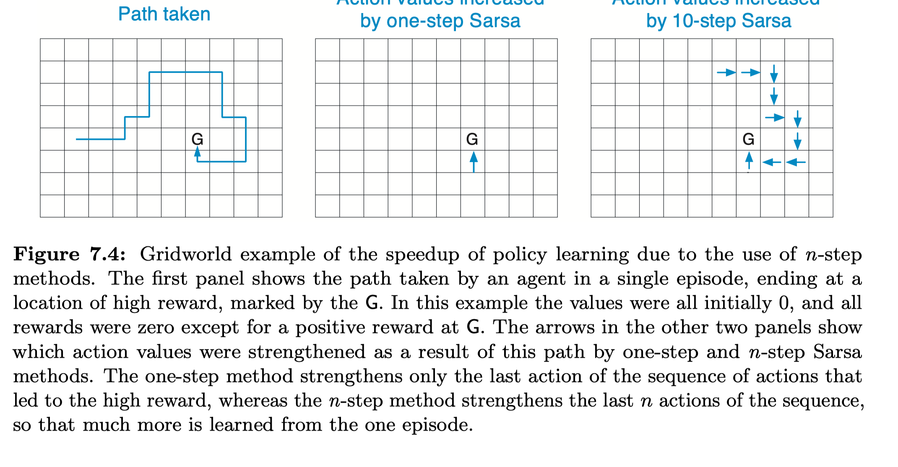
Sarsa(λ) Gridworld Example [Sutton Barto]
8/15/2024
FIT5226-S2-2024
24/65

Slide 25
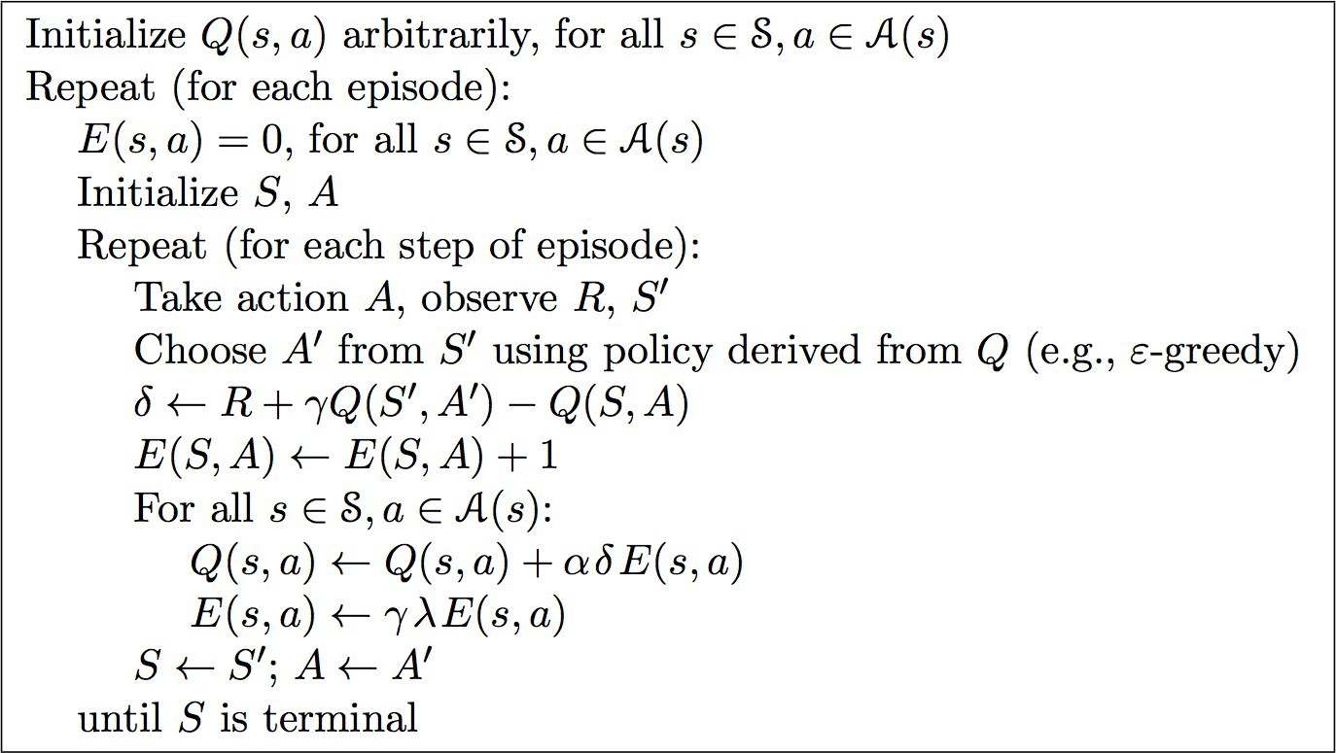
Sarsa(λ) Algorithm

Slide 26
Backward View TD(λ)
Forward view (above) provides theory
Backward view provides implementation mechanism
updates online, every step, from incomplete sequences
8/15/2024
FIT5226-S2-2024
26/65

Slide 27
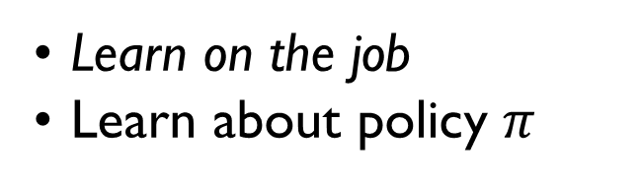



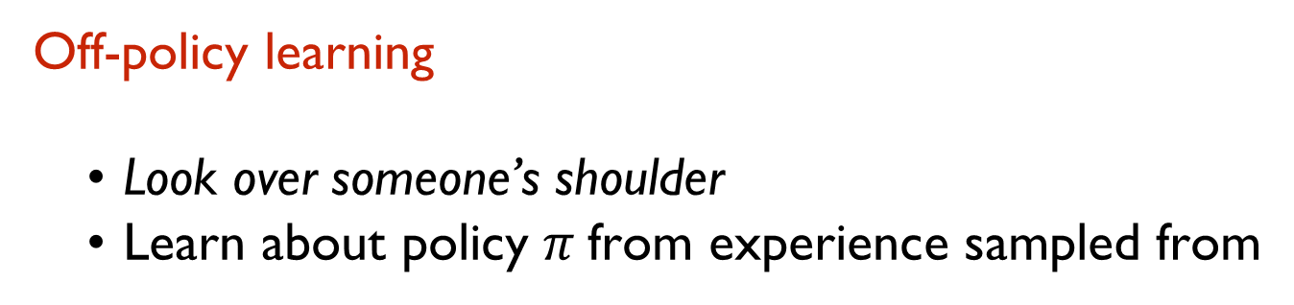
On-Policy vs Off-Policy Learning
On-policy learning
Learn on the job
Learn about policy $π$
from experience sampled from
$$π$$
Off-policy learning
Look over someone’s shoulder
Learn about policy $π$ from experience sampled from
$$μ$$
someone’s shoulder = behaviour policy = $μ$
Notes:
On-policy learning and off-policy learning are two fundamental concepts in the field of reinforcement learning that relate to how an agent interacts with its environment, collects data, and updates its value estimates.
On-Policy Learning:
In on-policy learning, the agent's policy (strategy) for selecting actions is the same policy that is being updated and evaluated.
The agent learns by interacting with the environment using its current policy, collecting experiences (state-action-reward-next state tuples) and updating its value estimates based on those experiences.
The agent explores the environment and makes updates based on the actual actions it takes under its current policy.
Example algorithms: SARSA (State-Action-Reward-State-Action), Expected SARSA, A2C (Advantage Actor-Critic).
Off-Policy Learning:
In off-policy learning, the agent learns by observing and interacting with data generated by a different policy, called the behavior policy, while updating a target policy.
The behavior policy generates exploratory actions to gather data, while the target policy is being updated based on the observed data to improve the agent's decision-making.
The agent can learn from past experiences generated by different policies, allowing for more efficient exploration and better convergence.
Example algorithms: Q-learning, DDPG (Deep Deterministic Policy Gradient), TD3 (Twin Delayed Deep Deterministic Policy Gradient), SAC (Soft Actor-Critic).

Slide 28
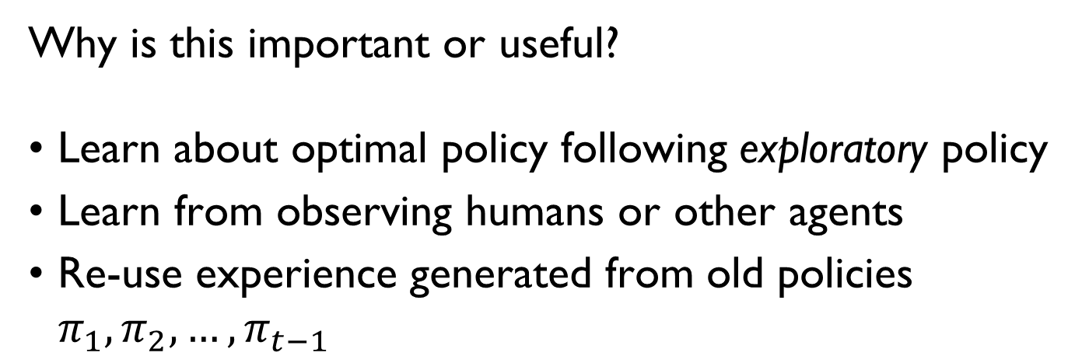
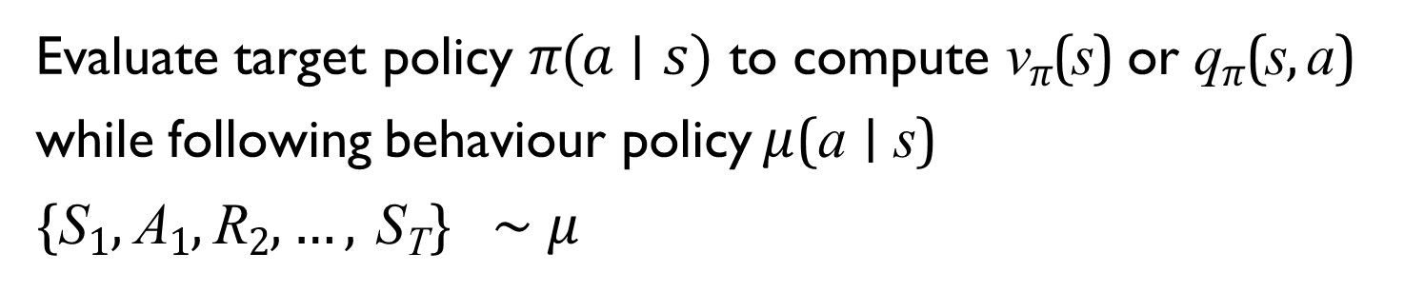
Evaluate target policy $π(a∣s)$to compute v$π$(s) or q$π$(s, a) while following behaviour policy$μ$(a ∣ s)
{S₁, A₁, R₂, …, S_{T}} ∼ $μ$
Off-Policy Learning
Why is this important or useful?
Learn about optimal policy following exploratory policy
Learn from observing humans or other agents
Re-use experience generated from old policies $π_{1}, π_{2}, …, π_{t−1}$

Slide 29
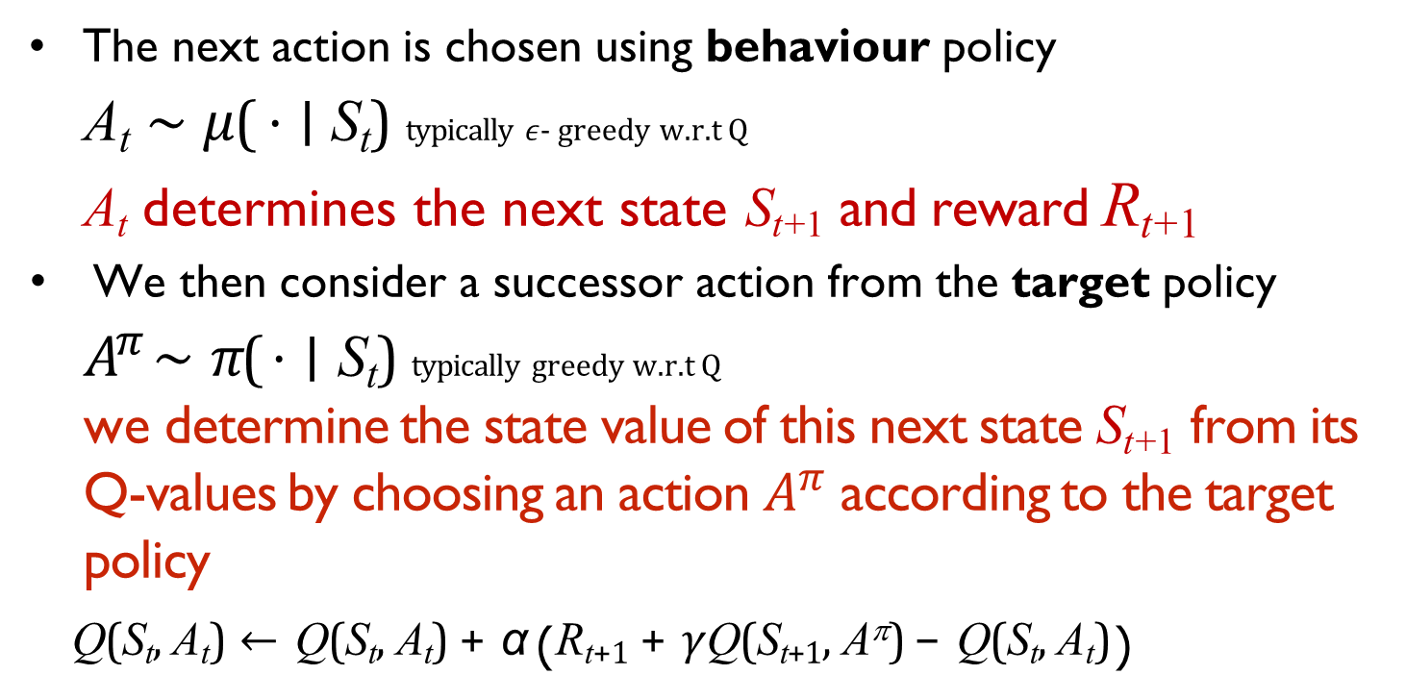
We now consider off-policy learning of action-values Q(s, a)
Q-Learning
The next action is chosen using behaviour policy
A_{t} ∼ $μ$( ⋅ ∣ S_{t}) typically $ε$- greedy w.r.t Q
A_{t} determines the next state S_{t+1} and reward R_{t+1}
We then consider a successor action from the target policy
$A^{π}$ ∼ $π$( ⋅ ∣ S_{t}) typically greedy w.r.t Q we determine the state value of this next state S_{t+1} from its Q-values by choosing an action $A^{π}$ according to the target policy
Q(S_{t}, A_{t}) ← Q(S_{t}, A_{t}) + α ₍R_{t+1} + $γ$Q(S_{t+1}, A^{π}) − Q(S_{t}, A_{t})₎
8/15/2024
FIT5226-S2-2024
29/65

Slide 30
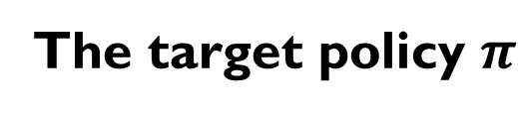
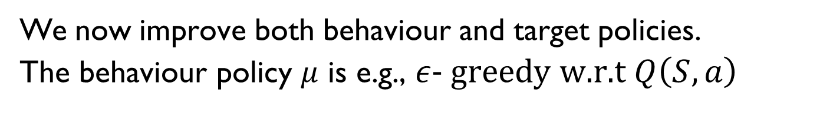
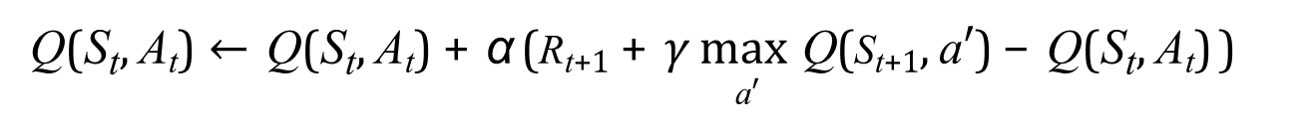
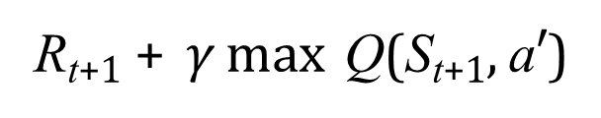
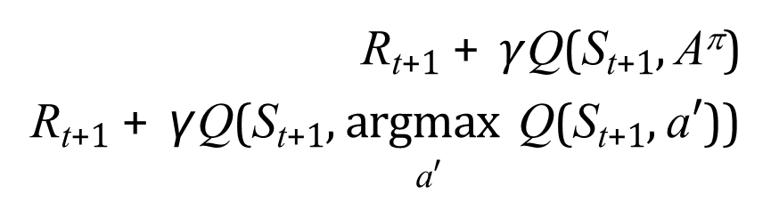
Off-Policy Control with Q-Learning
We now improve both behaviour and target policies.
The behaviour policy $μ$ is e.g., $ε$- greedy w.r.t $Q\left(S, a\right)$
The target policy $π$
is greedy w.r.t. Q(S, a)
π (S_{t+1}) = argmax Q(S_{t+1}, a′) a′
The Q-learning target then simplifies:
R_{t+1} + $γ$Q(S_{t+1}, A^{π})
R_{t+1} + γ Q(S_{t+1}, argmax Q(S_{t+1}, a′))
a′
TD target
=
=
R_{t+1} + $γ$ max Q(S_{t+1}, a′)
a′
Q(S_{t}, A_{t}) ← Q(S_{t}, A_{t}) + α (R_{t+1} + $γ$ max Q(S_{t+1}, a′) − Q(S_{t}, A_{t}))
a′

Slide 31
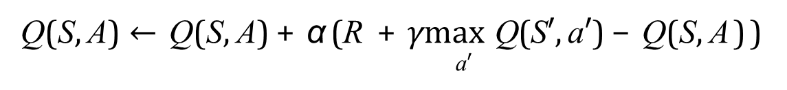
Q-Learning Control
Q(S, A) ← Q(S, A) + α (R + $γ$max Q(S′, a′) − Q(S, A))
a′
Theorem
Q-learning control converges to the optimal action-value function,
Q(s, a) → q⋆(s, a)
8/15/2024
FIT5226-S2-2024
31/65

Slide 32
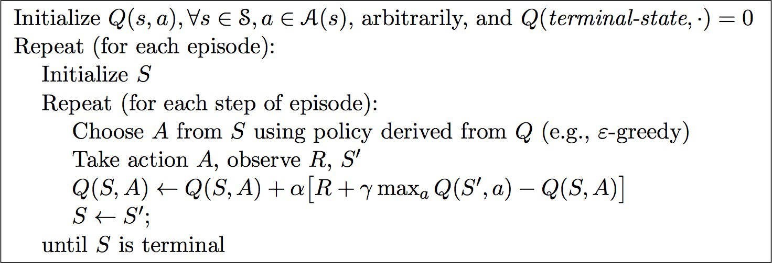
Q-Learning Algorithm for Off-Policy Control
8/15/2024
FIT5226-S2-2024
32/65

Slide 33
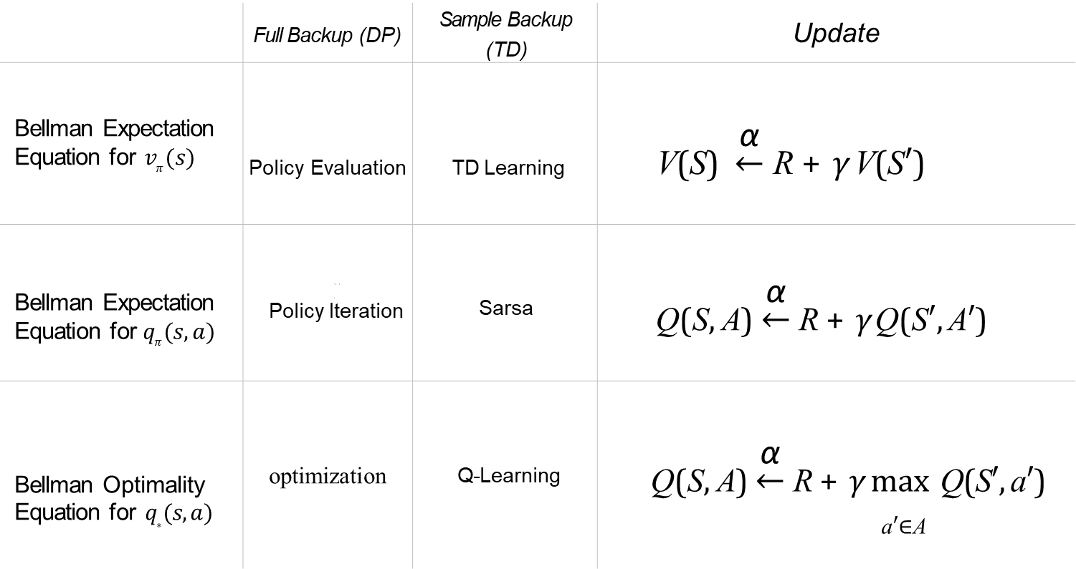
Relationship Between DP and TD
 | Full Backup (DP) | Sample Backup (TD) | Update
Bellman Expectation Equation for $v_{π}(s)$ | Policy Evaluation | TD Learning | V(S) $\underset{←}{\text{α}}$ R + $γ$ V(S′)
 | ,A R S’ A’ Policy Iteration | S,A A’ Sarsa
Bellman Expectation Equation for$q_{π}(s, a)$ |  | A’ Sarsa | Q(S, A) $\underset{←}{\text{α}}$ R +$γ$Q(S′, A′)
Bellman Optimality Equation for $q_{∗}(s, a)$ | optimization | Q-Learning | Q(S, A) $\underset{←}{\text{α}}$ R + $γ$max Q(S′, a′) a′∈A
α
where x ← y is x ← x + α(y − x)
8/15/2024
FIT5226-S2-2024
33/65

Slide 34
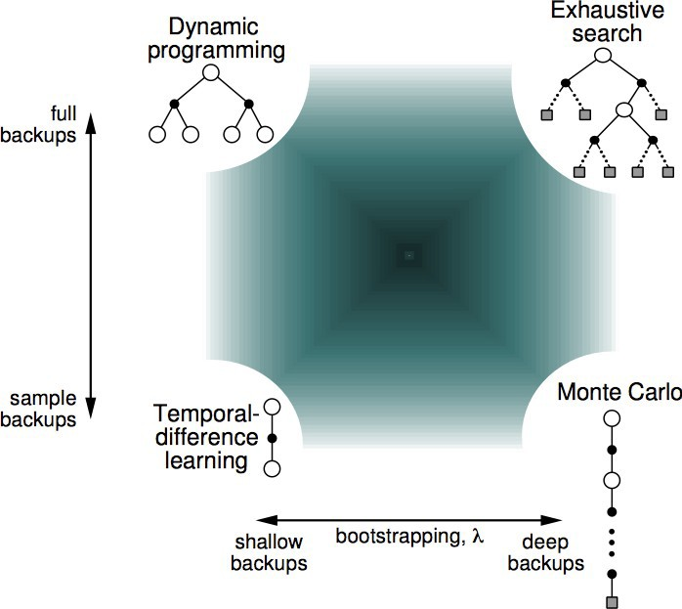
Unified View of Reinforcement Learning
8/15/2024
FIT5226-S2-2024
34/65

Slide 35
Acknowledgments
This material includes content adapted from instructional resources made available by David Silver as part of his Reinforcement Learning course at UCL under CC-BY-NC 4.0.
Refer to https://www.davidsilver.uk/teaching/ for full details
8/15/2024
FIT5226-S2-2024
35/65

